Slide 1
The National Economy: Recovering From the COVID-19 Shock
Thomas D. Simpson, Ph.D.
Department of Economics and Finance
UNCW

Slide 2
The biggest shock
2020 | Percent change in output (quarterly) | Change in unemployment rate
Q1 | -1.3 | 0.3
Q2 | -9.0 | 9.2
Q3 | 7.5 | -4.2
Q4e | 2.0 | -2.1
Q4 to Q4e | -1.5 | 3.2
e--Estimate

Slide 3
Uneven recovery
Employment change | Feb. to Nov.
Sector | Percent change
Total private | -6.6
Goods producing | -4.3
Construction | -3.6
Manufacturing | -4.6
Retail trade | -3.5
Warehousing & storage | 8.0
Air transportation | -23.9
Health care | -3.2
Arts, entertainment, rec. | -27.3
Accommodation | -31.0
Food and drinking | -17.2

Slide 4
Dramatic shift in spending on goods

Slide 5
Spending has outstripped production, resulting in lean inventories

Slide 6
Big-ticket spending has been brisk

Slide 7
Demand for housing robust

Slide 8
Home prices accelerating

Slide 9
Support from ultra-low interest rates
Low rates are buoying the stock and real estate markets.

Slide 10
Consumers have powder left—high saving rate

Slide 11
Overall Wealth positions are strong

Slide 12
Despite covid-19 setbacks, insured unemployment continues to drop

Slide 13
Looking ahead
Fundamentals suggest the economy will continue to have forward momentum.
Growth likely to be choppy over coming months.
Lean inventories are adding to producer order books and boosting production schedules.
Growth will quicken as COVID-19 comes under control, propelling growth in the second half of 2021.

Slide 14
The consumer will continue to fuel growth
Comfortable wealth positions.
Continued unwinding of high saving rate.
Favorable financing conditions.
However, not all consumers (and small businesses) will be participating.

Slide 15
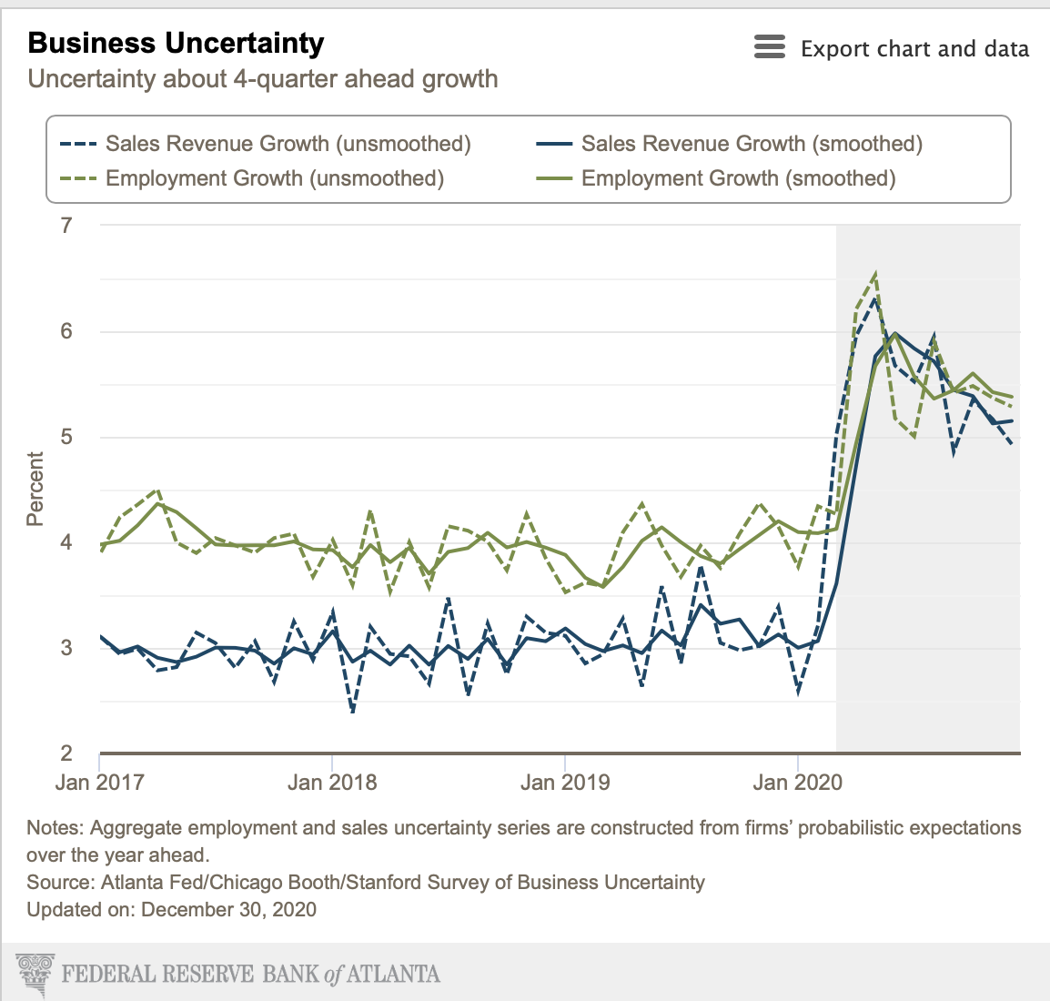
receding business uncertainty will trigger more business investment

Slide 16
The Weaker dollar will support exports

Slide 17
Upward drift in oil prices implies the global economy is firming

Slide 18
The recovery has routinely surprised on the upside
Fed Projections for | Output Growth in 2020
December 2019 | 2.0
June 2020 | -6.5
September 2020 | -3.7
December 2020 | -2.4

Slide 19
Improvement in the service sector will lag
By mid-2021, the hardest-hit components of the service sector should experience a pickup in growth.
Even though growth in those segments will exceed growth elsewhere, they will still take some time to return to early 2020 levels.
Note that the service sector is disproportionately small business (that are not in stock indexes).
The office and retail commercial real estate sectors will be struggling for much longer, owing to more telework and e-commerce.
A concern is prospective credit losses as forbearance ends.

Slide 20
Government policy will be a big uncertainty
The new administration will be pushing for more spending.
But, also higher corporate, capital gains, and personal tax rates.
There will be congressional resistance.
The administration will be reimposing regulations.

Slide 21
Fed policy will continue to be highly expansionary
Over the past year, Fed purchases of Treasury securities (in the secondary market) amounted to two-thirds of the $3.3 trillion federal deficit.
The Fed is committed to ongoing large-scale purchases, roughly matching the supply of new debt.
In addition, the Fed will be holding the federal funds rate at its lower bound for a considerable time.

Slide 22
Inflation has a lot of catching up to reach the 2 percent average target

Slide 23
Market participants do not see much tightening in the years ahead

Slide 24
Questions?
More commentary can be found on my website: Thomasdsimpson.com

